Slide 1
UNIT III

Slide 2
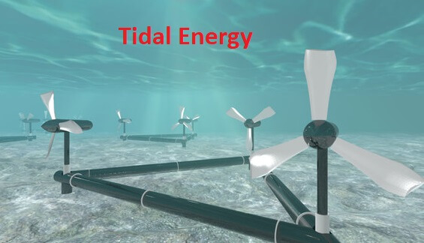

Slide 3
What is Tidal energy? The energy from the massive movement of water can be harnessed and which can be converted into a usable form of energy is called as Tidal energy. Origin of Tides: Tides are very long-period waves that move through the ocean in response to the forces exerted by the moon and sun. Tides originate in the ocean and progress toward the coastlines where they appear as the regular rise and fall of the sea surface.

Slide 4
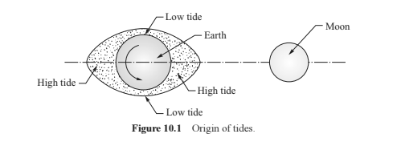
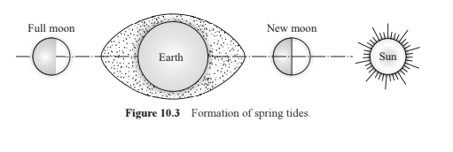
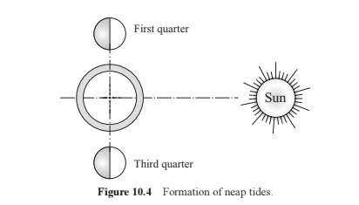
Origin of Tides Spring Tides Neap Tides

Slide 5
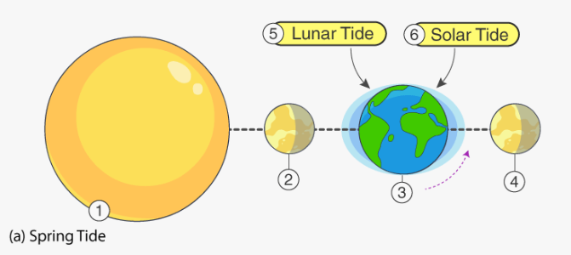
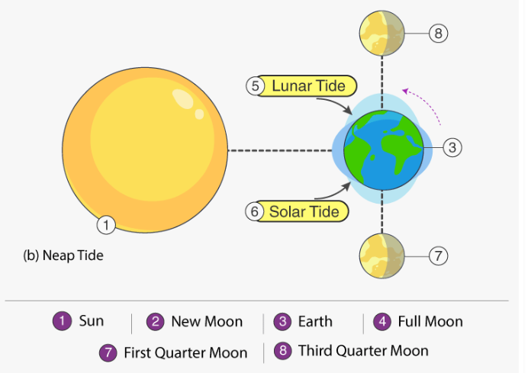
Alignment of Sun and Moon on the tides:

Slide 6
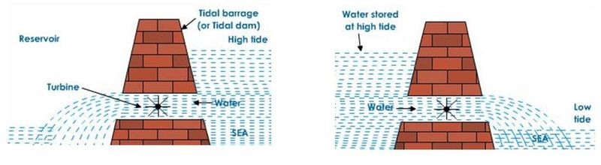
How tidal energy can be used to generate electricity? During high tide, when the level of water in the sea is high, sea-water flows into the reservoir of the barrage and turns the turbines. The turbines then turn the generator to produce the electricity. And during the low tide, when the level of sea-water is low, the sea-water stored in the barrage reservoir is allowed to flow out into the sea. This flowing water also turns the turbines and generates electricity.

Slide 7
Tidal energy is not likely to be a potential source of energy because there are very few sites around the world which are suitable for building tidal barrages, and the rise and fall of sea-water during high and low tides is not enough to generate electricity on a large scale.

Slide 8
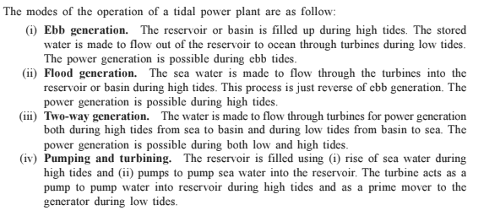
Modes of operation of Tidal Power Plant:

Slide 9
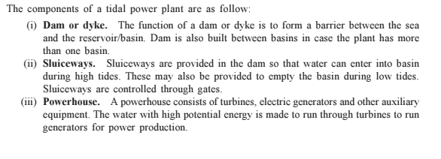
Components of Tidal Power Plant:

Slide 10
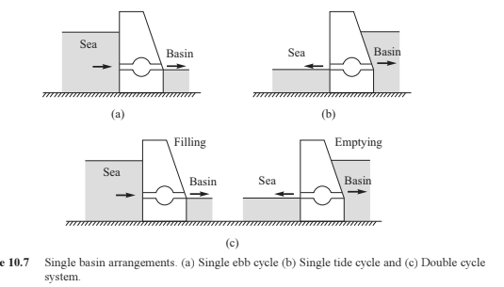
Classification of Tidal Plant: The Tidal plants are classified on the basis of basins used as i)Single Basin System ii)Double Basin System Single Basin System:

Slide 11
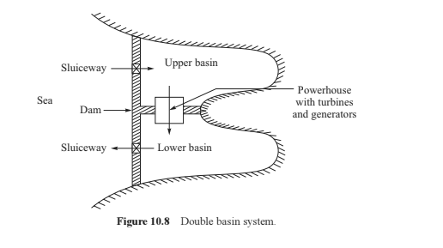
Double Basin System:

Slide 12
OCEAN THERMAL ENERGY

Slide 13
Ocean Thermal Energy is created by solar energy when ocean water absorbs solar radiation. The absorption of solar radiation causes a moderate temperature gradient to develop in water from the top surface to the bottom of the ocean. This temperature gradient can be utilized using a heat engine to generate power. This process of conversion is called ocean thermal energy conversion (OTEC).

Slide 14
Working principle of Ocean Thermal Energy Conversion

Slide 15
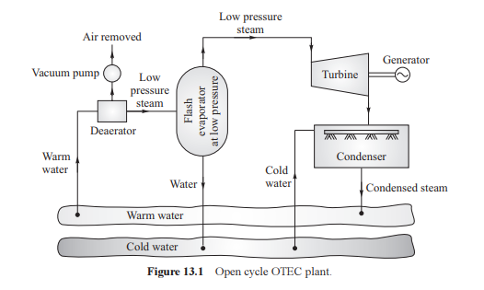
Ocean Thermal Energy Conversion System’s: Open Cycle:

Slide 16
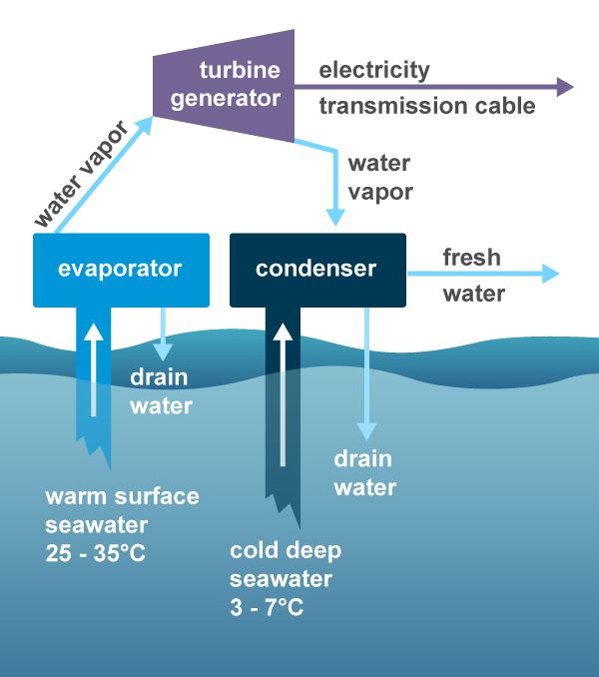

Slide 17
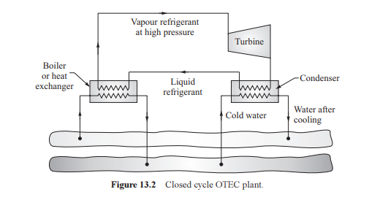
Ocean Thermal Energy Conversion System’s: Closed Cycle:

Slide 18
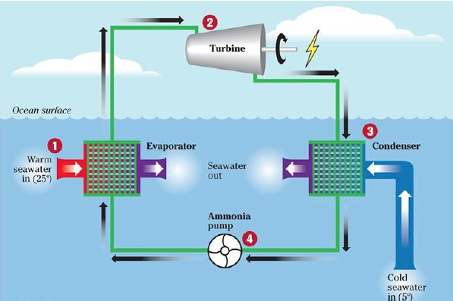

Slide 19
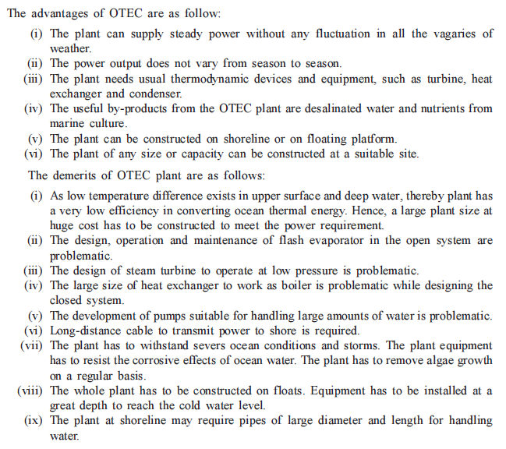

Slide 20
WAVE ENERGY

Slide 21
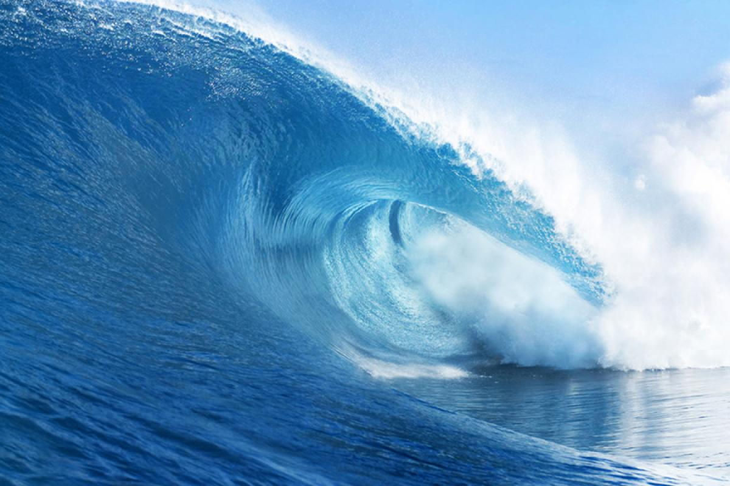
WAVE ENERGY

Slide 22
What is wave energy? Wave energy is a form of renewable energy that can be harnessed from the motion of the waves. Waves in ocean are caused by the transfer of wind energy to the water surface in the ocean. Depending upon the wind speeds and the distance over which wind interacts with water surface, stronger and higher waves can be formed.The wave energy depends on the amplitude of the wave and period of motion. Wave energy consists of kinetic energy resulting from propagation of wave and potential energy resulting from lifting of water mass with respect to mean sea level.The wave velocity depends upon wave length. The longer is the wave length, the faster it moves.

Slide 23
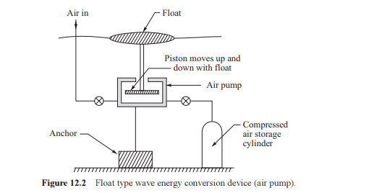
Wave Energy Devices: Heaving Float Type:

Slide 24
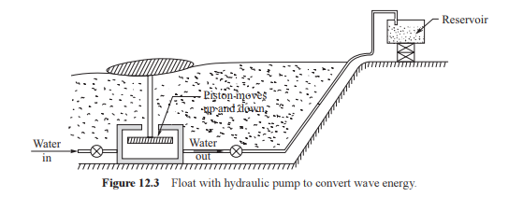
Float With Hydraulic Pump to convert wave energy:

Slide 25
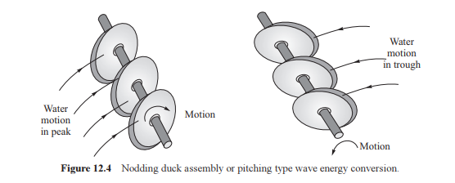
Pitching type wave energy conversion:

Slide 26
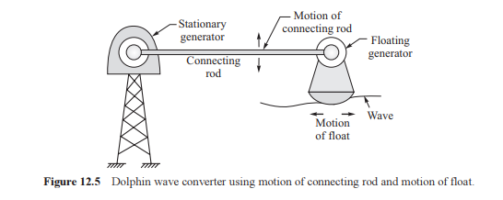
Heaving and Pitching floating type:

